Slide 1
Coupon Acceptance Prediction
- Parth Chauhan

Slide 2
Table of Contents
1
PROBLEM STATEMENT
This describes the problem statement for the project
2
EDA
This describes the behaviour of individual feature over target variable
3
KEY TAKEAWAYS
This describes what can be done in order to increase coupon acceptance
4
MODEL SELECTION
This describes the comparison of different classification model on Training & Validation data
5
MODEL PERFORMANCE
This describes the performance of final model

Slide 3

PROBLEM STATEMENT
STATEMENT
The goal of this project is to leverage machine learning techniques to analyze driving scenarios and user attributes collected from an e-commerce website. By accurately predicting whether users will accept coupons during their journeys, the aim is to optimize coupon distribution strategies and enhance user engagement with the platform's offerings.
The survey describes different driving scenarios including the user’s destination, current time, weather, passenger, coupon attributes, user attributes, and contextual attributes, and then asks the user whether he/she will accept the coupon or not.

Slide 4
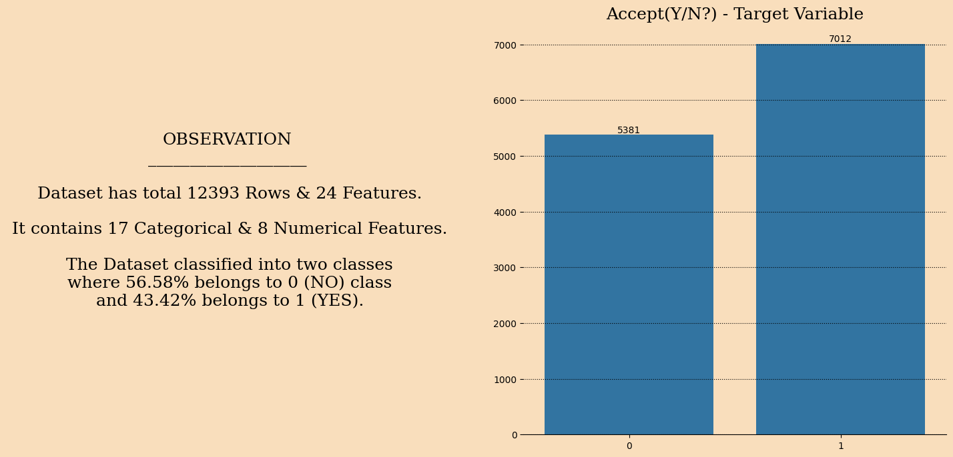
DATASET
BAGGING CLASSIFIER

Slide 5
APPROACH
DATA
PRE-PROCESSING
EDA
STATISTICAL ANALYSIS
MODEL SELECTION
METRICS
DATA DUPLICATES
COUNT PLOT (HUE)
CORRELATION
LOGISTIC REGRESSION
ACCURACY SCORE
NULL VALUE
TREATMENT
KDE PLOT (HUE)
ANOVA
DECISION TREE
CLASSIFICATION REPORT
FEATURE
ANALYSIS
HEAT MAP
CHI SQUARE TEST
RANDOM
FOREST
CONFUSION
MATRIX
ENCODING
GRADIENT BOOSTING
ROC- AUC CURVE
ADA BOOST
BAGGING CLASSIFIER
KNN
BERNOULLI NAIVE BAYES
MULTINOMIAL NAIVE BAYES
XGBOOST

Slide 6
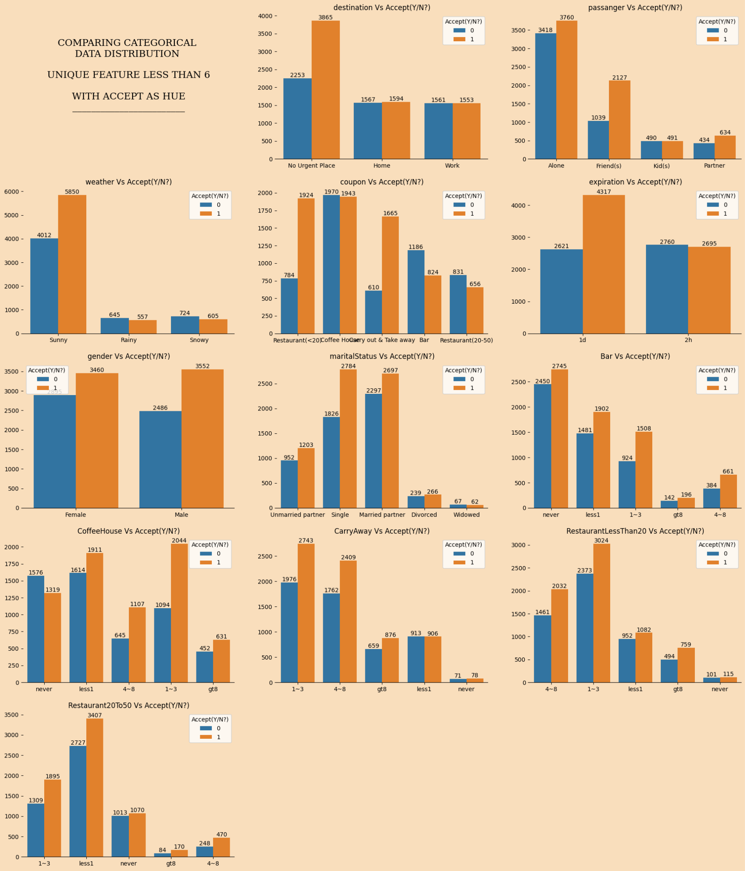
CATEGORIC
FEATURE
ANALYSIS

Slide 7
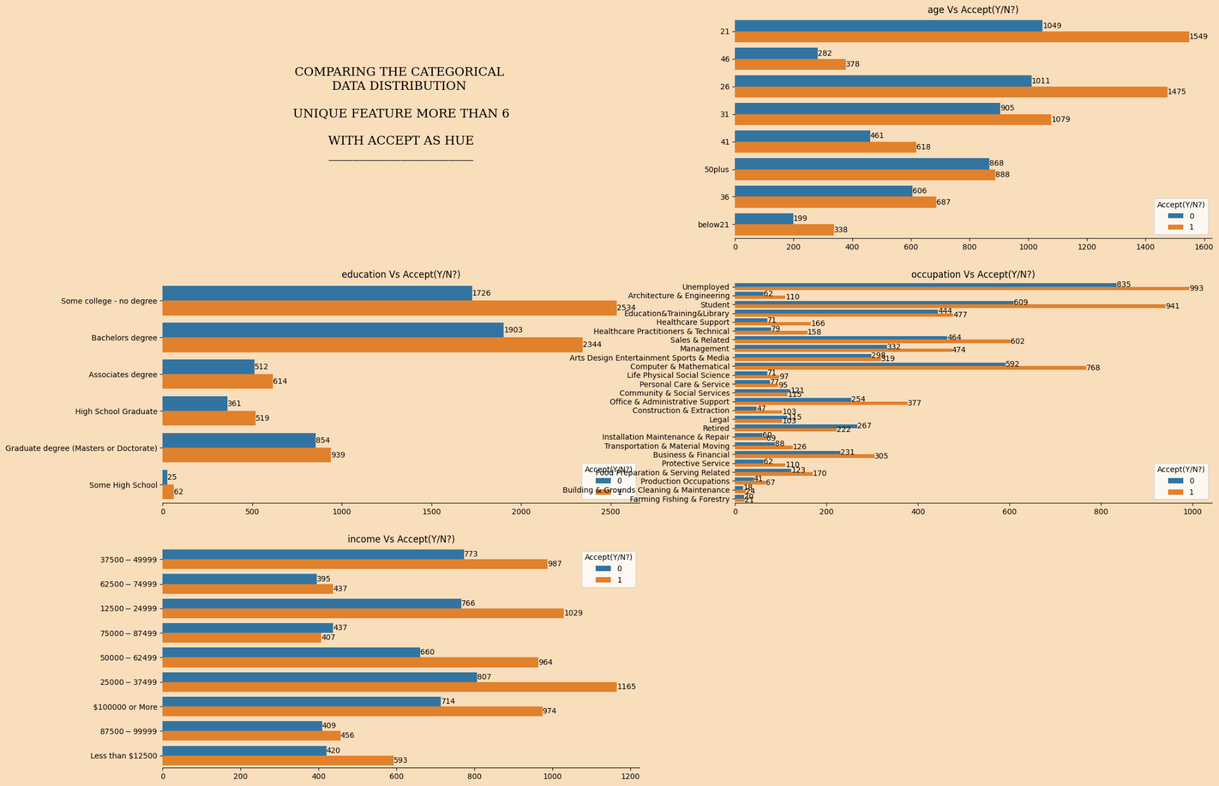
CATEGORIC
FEATURE
ANALYSIS

Slide 8
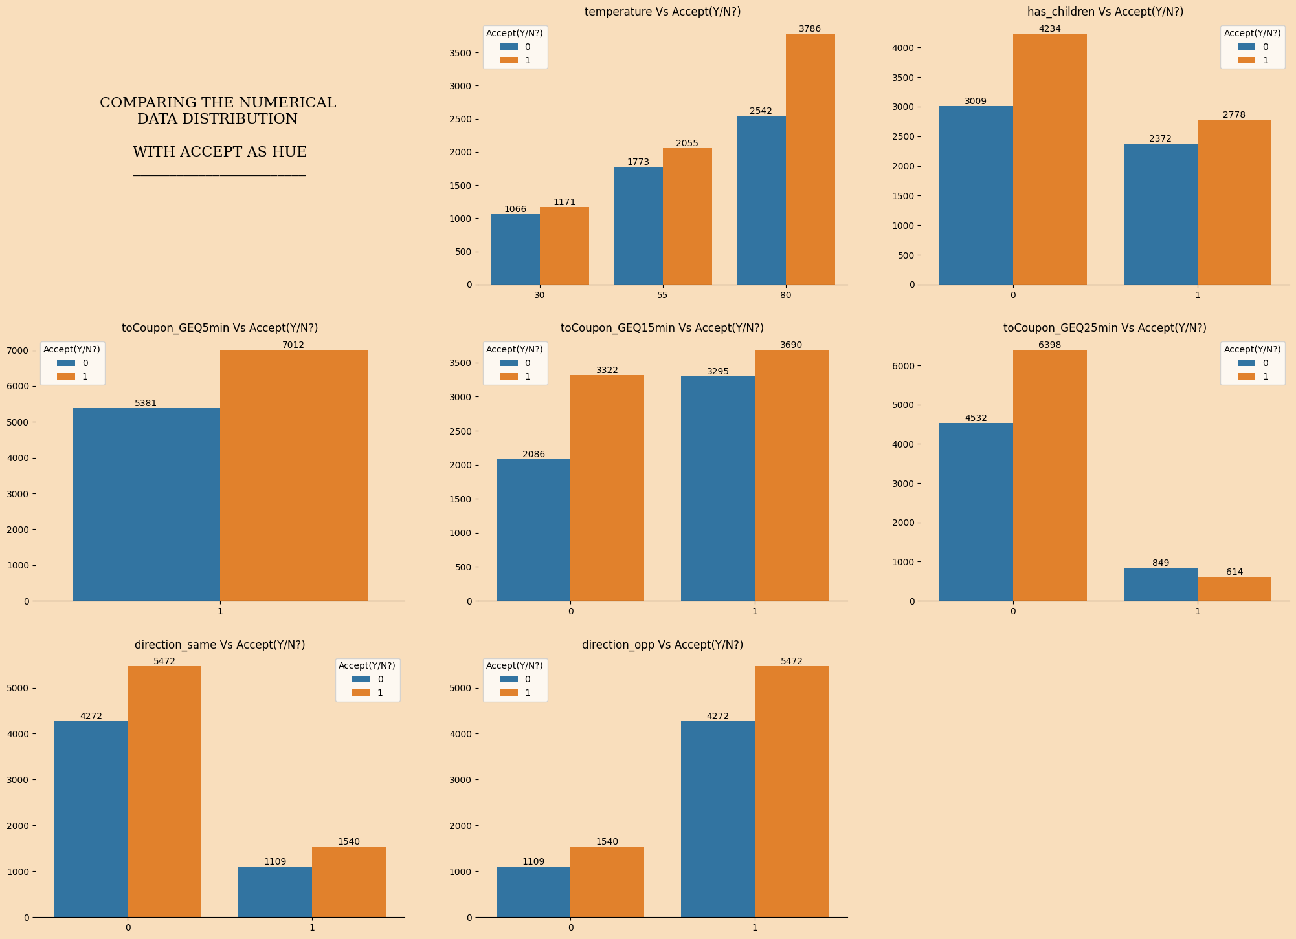
NUMERIC
FEATURE
ANALYSIS

Slide 9
STATISTICAL INFERENCE
Travel Context
Destination: "No Urgent Place" destinations show highest coupon usage. Target those without fixed destinations.
Passenger: Solo travelers ("Alone") most likely to use coupons. Consider targeting solo travelers specifically.
Situational Factors
Weather: Sunny weather & high temperature correlates with higher coupon acceptance. Explore weather-based promotions.
Travel Direction: Coupons aligned with travel direction have much higher acceptance. Ensure relevance to travel plans.
Drive Time: Less drive time coupons are more likely to be accepted than drive time more than 25 minutes
Coupon Characteristics
Coupon Type: Restaurant with price <20 and carry-out options are most popular
Expiry: Short expiration times ("1 Day") significantly increase acceptance. Emphasize on urgency.
Dining Preferences:
Bar Coupons: It has low acceptance rates. Explore alternative strategies for bar promotions.
Coffee House: Moderate acceptance. Potential for increased engagement with targeted campaigns.
Carry Away: Moderate acceptance. Opportunities to promote more frequent carry-away purchases.
Restaurant <$20: High acceptance, confirming preference for affordable dining.
Restaurant ($20-$50): Lower acceptance than cheaper options. Consider price sensitivity.
Demographics
Gender: Females slightly more likely to use coupons than males.
Marital Status: "Unmarried partner" and "Single" show highest acceptance. Tailor offers to relationship statuses.
Age: Youngest (25-29) and oldest (50+) groups show higher acceptance, but the relationship with age is complex. Investigate further.
Education: Higher education levels strongly correlate with increased coupon acceptance. Target higher education demographics.
Occupation: Certain occupations (e.g., "Healthcare Practitioners") show higher acceptance. Analyze occupation-based trends.
Income: Higher income levels strongly correlate with increased coupon acceptance. Prioritize higher-income targeting.
Individuals without children are more likely to accept coupons.

Slide 10



CONCLUSION
Key Takeaways
Prioritize Urgency and Value: Emphasize short expiration times. Focus on lower-priced options and discounts.
Target Strategically: Optimize coupon distribution by considering contextual factors. Focus on locations other than home or work, leverage favorable weather conditions (like sunny days), and travel situations (e.g., solo travelers).
Personalize for Relevance: Enhance engagement by personalizing coupon offers. Consider demographic factors like gender, relationship status, and dining preferences to create more relevant and appealing promotions.
Leverage Education and Income Insights: Recognize that higher education and income levels are strong indicators of coupon acceptance. Target these demographics with campaigns to maximize redemption rates.
Understand Occupational Influences: Acknowledge that occupation often reflects underlying socioeconomic factors that influence coupon usage. Analyze occupational data to refine targeting strategies and potentially uncover specific needs or preferences within different professions.
Situational Relevance is Key: Coupon acceptance is heavily influenced by factors like temperature, travel direction, and the perceived effort required to obtain the coupon.
Convenience and Value Perception: Readily available coupons (5-15 minutes) have low acceptance, possibly due to perceived lack of value. Coupons requiring a small wait (25 minutes) have higher acceptance.
Targeting Opportunities: Consider weather-based promotions, tailor coupons to individuals without children, and ensure coupons align with travel direction for maximum redemption.

Slide 11
MODEL TRAINING AND EVALUATION
Data Splitting
Performance Metrics
80% training, 20% testing split for model evaluation.
Evaluated model using Accuracy Score, Classification report, Confusion matrix.
Hyperparameter Tuning
Apply GridSearchCV to optimize model parameters

Slide 12
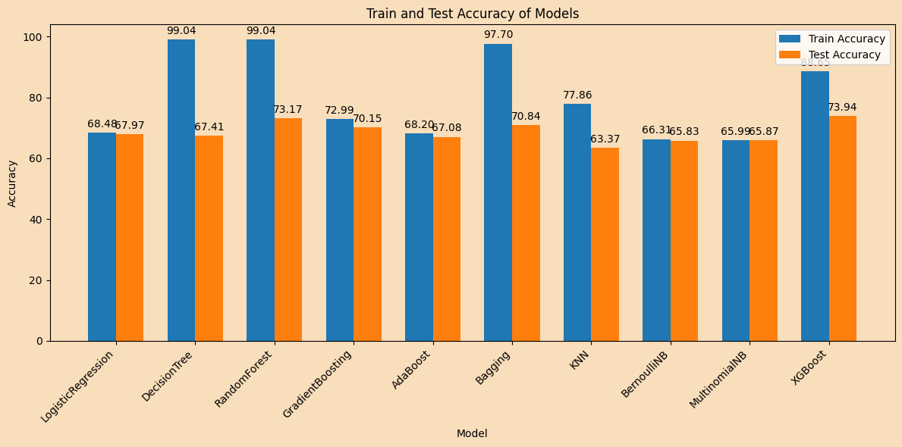
MODEL SELECTION

Slide 13
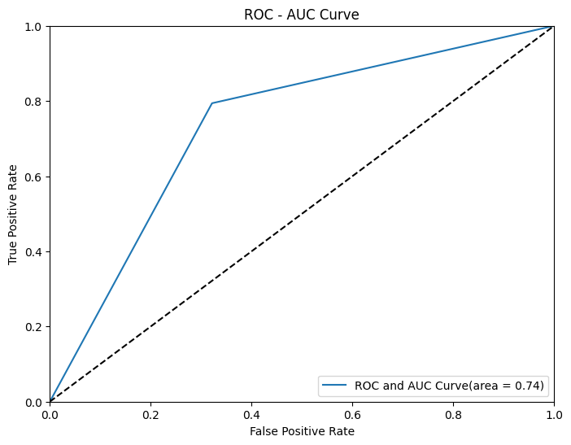
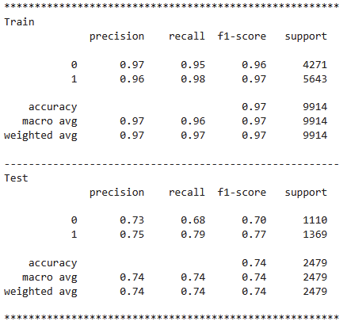
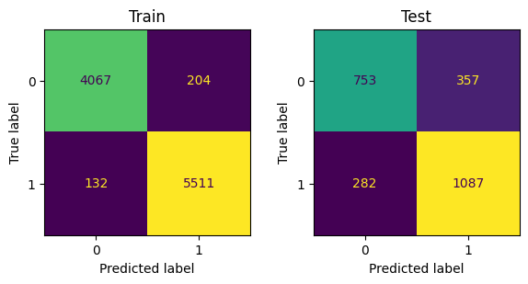
METRICS PERFORMANCE
Training Accuracy = 97%
Testing Accuracy = 74%

